Slide 1


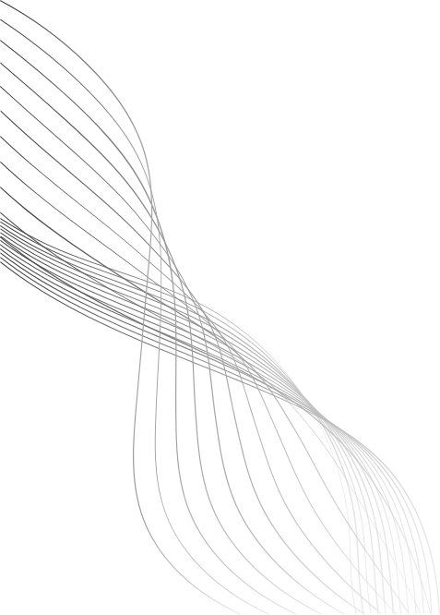
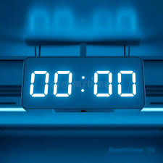
WORLD TIME ZONE DIGITAL CLOCK
A WEB-BASED INTERACTIVE CLOCK WITH TIME ZONE SELECTOR
Name : J. Pavan Tej
Organization : Micro IT

Slide 2
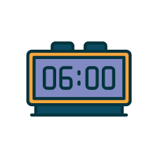
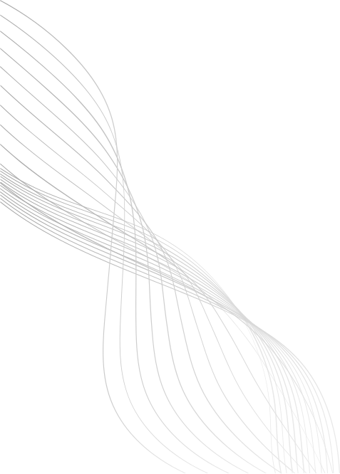
INTRODUCTION
The goal of this project is to create a beautiful and interactive digital clock.
The clock shows current time based on user-selected time zones.
It is fully responsive and can be run in any modern web browser.
02

Slide 3
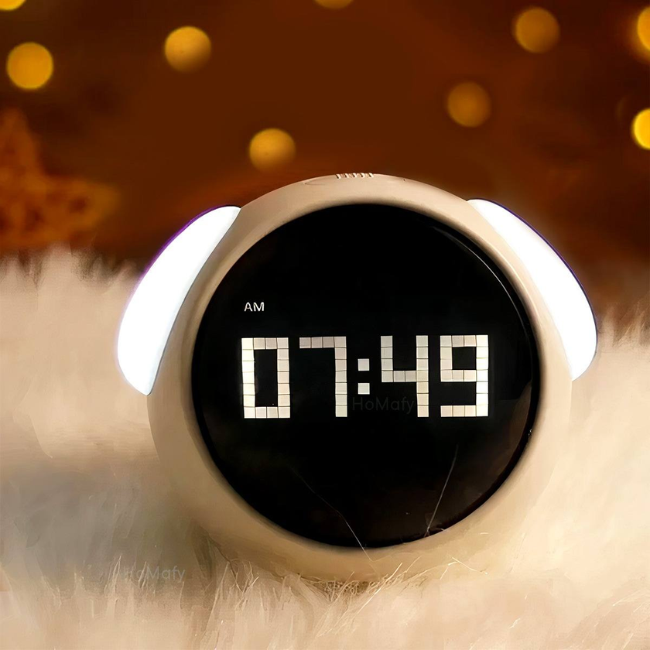
FEATURES
Live digital clock updates every second.
Dropdown menu to select from various global time zones.
Stylish, modern UI using HTML, CSS, and JavaScript.
Responsive design for mobile and desktop.
Footer credit with animated styling.
03

Slide 4
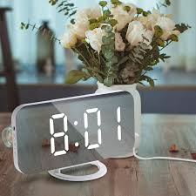
TECHNOLOGIES USED
HTML5: Structure and elements of the webpage.
CSS3: Styling, layout, and animations.
JavaScript: Real-time clock functionality and time zone handling.
Intl.DateTimeFormat API: For accurate time zone rendering.
04

Slide 5
CODE(HTML)
<!DOCTYPE html>
<html lang="en">
<head>
<meta charset="UTF-8">
<title>World Time Zone Clock</title>
<link href="https://fonts.googleapis.com/css2?family=Poppins:wght@400;600&display=swap" rel="stylesheet">
<link rel="stylesheet" href="styles.css">
</head>
<body>
<h1>World Time Zone Clock</h1>
<div class="container">
<label for="timezone">Select Time Zone:</label>
<select id="timezone">
<option value="Asia/Kolkata">India</option>
<option value="America/New_York">New York</option>
<option value="Europe/London">London</option>
<option value="Asia/Tokyo">Tokyo</option>
<option value="Australia/Sydney">Sydney</option>
</select>
<div class="clock" id="clockDisplay">00:00:00</div>
</div>
<footer>
Created by <span>J. Pavan Tej</span>
</footer>
<script src="script.js"></script>
</body>
</html>
05

Slide 6
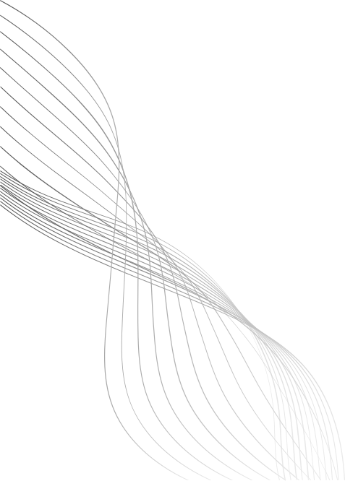
CODE(CSS)
* {
margin: 0;
padding: 0;
box-sizing: border-box;
}
body {
font-family: 'Poppins', sans-serif;
background: linear-gradient(135deg, #89f7fe 0%, #66a6ff 100%);
display: flex;
flex-direction: column;
align-items: center;
justify-content: space-between;
height: 100vh;
text-align: center;
}
h1 {
font-size: 2.5em;
color: #fff;
margin-top: 40px;
}
.container {
background: rgba(255, 255, 255, 0.15);
box-shadow: 0 8px 32px 0 rgba(31, 38, 135, 0.37);
backdrop-filter: blur(8px);
-webkit-backdrop-filter: blur(8px);
border-radius: 20px;
padding: 30px 40px;
color: #fff;
margin-top: 20px;
}
select {
padding: 12px 20px;
border: none;
border-radius: 8px;
font-size: 16px;
margin-top: 10px;
background-color: #ffffffcc;
color: #333;
}
border-radius: 8px;
}
.clock {
font-size: 3em;
margin-top: 30px;
font-weight: 600;
text-shadow: 2px 2px 5px rgba(0, 0, 0, 0.3);
}
footer {
margin-bottom: 20px;
color: #fff;
font-size: 16px;
opacity: 0.9;
}
footer span {
font-weight: bold;
color: #000;
background: rgba(255, 255, 255, 0.6);
padding: 4px 10px;
06

Slide 7
CODE(JAVASCRIPT)
const timezoneSelector = document.getElementById("timezone");
const clockDisplay = document.getElementById("clockDisplay");
function updateClock() {
const selectedTimeZone = timezoneSelector.value;
const now = new Date();
const options = {
timeZone: selectedTimeZone,
hour: '2-digit',
minute: '2-digit',
second: '2-digit',
hour12: false
};
clockDisplay.textContent = new Intl.DateTimeFormat('en-GB', options).format(now);
}
setInterval(updateClock, 1000);
timezoneSelector.addEventListener("change", updateClock);
updateClock();
07

Slide 8
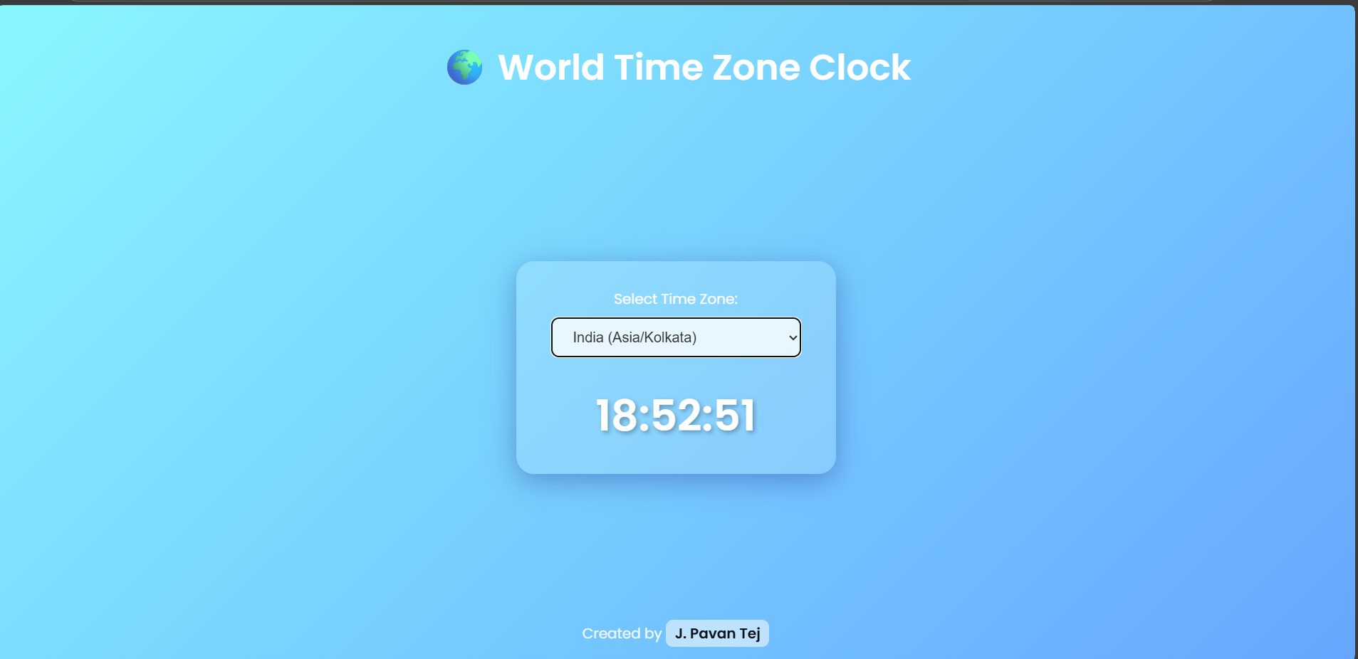
OUTPUT
08

Slide 9
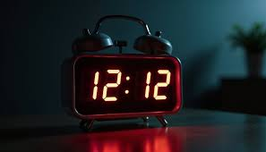
CHALLENGES FACED
Handling accurate time conversion across all time zones.
Ensuring responsiveness for all screen sizes.
Applying clean and modern UI styles.
09

Slide 10
FUTURE ENHANCEMENTS
Add multiple clocks to view different zones simultaneously.
Add calendar and date display.
Enable alarm and timer features.
Toggle between light and dark modes.
10

Slide 11
CONCLUSION
This project demonstrates the integration of real-time functionality with a beautiful user interface.
It’s a great start for deeper projects involving time, scheduling, or international apps.
11

Slide 12
THANK YOU
12

